Slide 1
Introduction To Q-learning
Scott O’Hara
Metrowest Developers Machine Learning Group

Slide 2
References
“Demystifying Deep Reinforcement Learning,” 2015, Tambet Matiisen
https://www.intel.ai/demystifying-deep-reinforcement-learning/
CS188 course at University of California, Berkeley:
CS188 – Introduction to Artificial Intelligence, Profs. Dan Klein, Pieter Abbeel, et al. http://ai.berkeley.edu/home.html
CS181 course at Harvard University:
CS181 Intelligent Machines: Perception, Learning and Uncertainty, Sarah Finney, Spring 2009
CS181 Intelligent Machines: Perception, Learning and Uncertainty, Prof. David C Brooks, Spring 2011
CS181 – Machine Learning, Prof. Ryan P. Adams, Spring 2014. https://github.com/wihl/cs181-spring2014
CS181 – Machine Learning, Prof. David Parkes, Spring 2017. https://harvard-ml-courses.github.io/cs181-web-2017/
Reinforcement learning: an introduction R. S. Sutton and A. G. Barto, Second edition. Cambridge, Massachusetts: The MIT Press, 2018.
The material for this talk is primarily drawn from the slides, notes and lectures of these courses with occasional reference to Sutton and Barto’s book.

Slide 3
UC Berkeley CS188 is a great resource!
Websites:
http://ai.berkeley.edu/home.html
http://gamescrafters.berkeley.edu/~cs188/sp20/
http://gamescrafters.berkeley.edu/~cs188/{sp|fa}<yr>/
Covers:
Search
Constraint Satisfaction
Games
Reinforcement Learning
Bayesian Networks
Surveys Advanced Topics
And more…
Features:
Contains high quality YouTube videos, PowerPoint slides and homework.
Projects are based on the video game PacMan.
Material is used in many courses around the country.

Slide 4
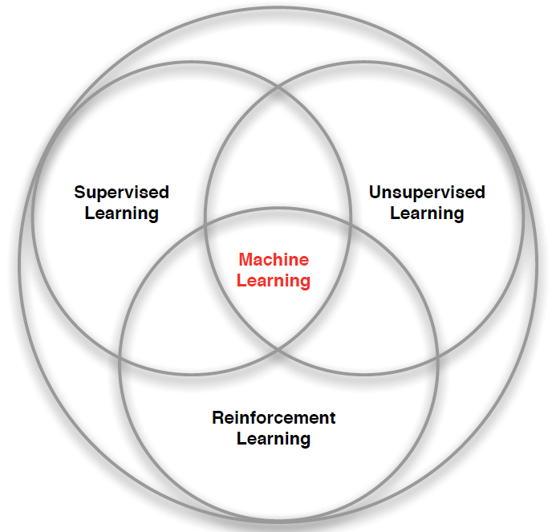
3 Types of Machine Learning
Supervised Learning – Learn a function from labeled data that maps input attributes to an output label e.g., linear regression, decision trees, SVMs.
Unsupervised Learning – Learn patterns in unlabeled data e.g., principle component analysis or clustering algorithms such as K-means, HAC, or Gaussian mixture models.
Reinforcement Learning – An agent learns to maximize rewards while acting in an uncertain environment.
Credit: image borrowed from lecture slides David Silver, DeepMind, “Introduction to Reinforcement Learning

Slide 5
The Markov Decision Process
The Markov Decision Process (MDP) provides a mathematical framework for reinforcement learning.
Markov decision processes use probability to model uncertainty about the domain.
Markov decision use utility to model an agent’s objectives. The higher the utility, the “happier” your agent is.
MDP algorithms discover an optimal decision policy π specifying how the agent should act in all possible states in order to maximize its expected utility.

Slide 6
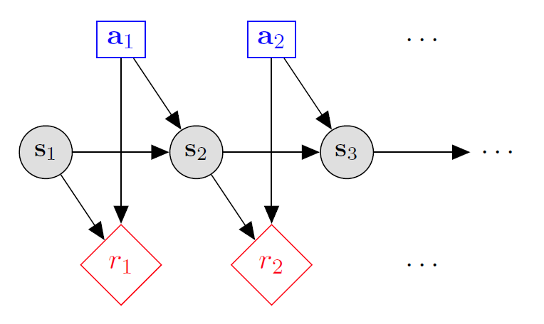

Markov decision processes
States: $s_{1},…,s_{n}$
Actions: $a_{1},…,a_{m}$
Reward Function:
$r\left(s,a,s′\right)∈R$
Transition model:
T(s,a,s’)= $P\left(s′ | s, a\right)$
Discount factor: $γ∈\left[0,1\right]$
<https://en.wikipedia.org/w/index.php?title=Markov_decision_process&oldid=855934986> [accessed 11 September 2018]

Slide 7
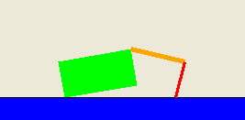
Application: Crawler robot
Arm
Location
Hand
States: <Location, Arm angle, Hand angle>
Actions: increase Arm angle, decrease Arm angle,
increase Hand angle, decrease Hand angle.
Reward Function: +1 if robot moves right, -1 if robot moves left.
Transition model: model of box movement caused by arm movements.

Slide 8
Algorithms Based on the Markov Decision Process
Classifying algorithms based on the Markov Decision Process
One way to classify these algorithms is on how much is known about the environment.
MDP algorithms
These algorithms assume perfect knowledge of the states, actions, rewards and transitions of the problem space.
Reinforcement learning algorithms:
These algorithms have knowledge of the states and actions but have no knowledge of the rewards and transitions of the problem space.

Slide 9
4 mdp algorithms
Expectimax – a top-down recursive tree search algorithm similar to the minimax game search algorithm with a fixed search depth (finite horizon) that finds the optimal expected value of the current state.
Finite Horizon Value Iteration – a bottom-up dynamic programming algorithm that finds the optimal expected value of every state within a finite horizon.
Infinite Horizon Value Iteration – a bottom-up dynamic programming algorithm that finds the optimal expected value of every state.
Policy Iteration - a bottom-up dynamic programming algorithm that finds the optimal policy.

Slide 10
The Reinforcement Learning Problem
Agent
State: s’
Reward: r
Actions: a
Environment
Agent must learn to act to maximize expected rewards.
Agent knows the current state s, takes action a, receives a reward r and observes the next state s’.
Agent has no access to the reward model r(s,a,s’) or the transition model T(s,a,s’).
All learning is based on observed samples of outcomes.

Slide 11
Reinforcement learning algorithms
Model-based RL algorithms are based on the various MDP algorithms and try to learn the reward and transition models by exploring the environment.
Model-free RL algorithms ignore the reward and transition models and try to learn the value functions directly.

Slide 12
Model-Based RL pros and Cons
Pros:
Makes maximal use of experience.
Solves model optimally, given enough experience.
Cons:
Requires a computationally expensive solution procedure.
Requires the model to be small enough to solve

Slide 13
Model-Free RL pros and Cons
Pros:
The solution procedure is much more efficient.
Can handle much larger models.
Cons:
Learns more slowly.
Does not learn as much as a model-based RL in a single training episode since it doesn’t learn the transition and reward models.
Conclusion:
Model-free approaches are used for most real-world problems.
Examples: Q-Learning, Monte Carlo, SARSA, TD-Learning, Deep QL, etc.

Slide 14
Q-Learning

Slide 15
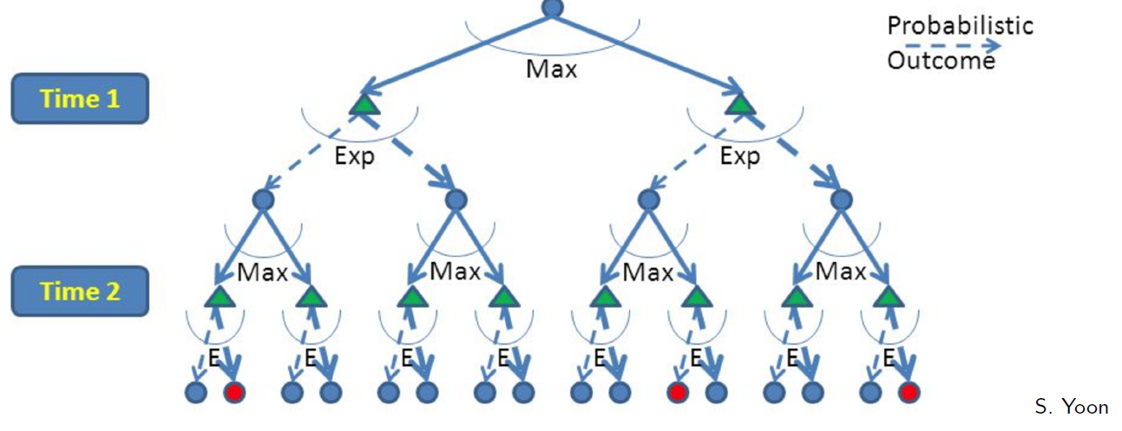
RL is like A game against Nature
Reinforcement learning is like a game-playing algorithm.
Nodes where you move are called states: S ( )
Nodes where nature “moves” are called Q-states: <S,A> ( )
Credit: CS188 – Intro to AI, UC Berkeley, ai.berkeley.edu

Slide 16
Quantities to optimize
The value (utility) of a state s:
V(s) = expected utility starting in s and acting optimally
The value (utility) of a q-state (s,a):
Q(s,a) = expected utility starting out having taken action a from state s and (thereafter) acting optimally
The optimal policy:
π(s) = optimal action from state s
s
s is a state
a
(s, a) is a q-state
s, a
s,a,s’
(s,a,s’) is a transition
s’
Credit: CS188 – Intro to AI, UC Berkeley, ai.berkeley.edu
Notes:
Demo just shows V and Q values, snapshots on next slides.

Slide 17
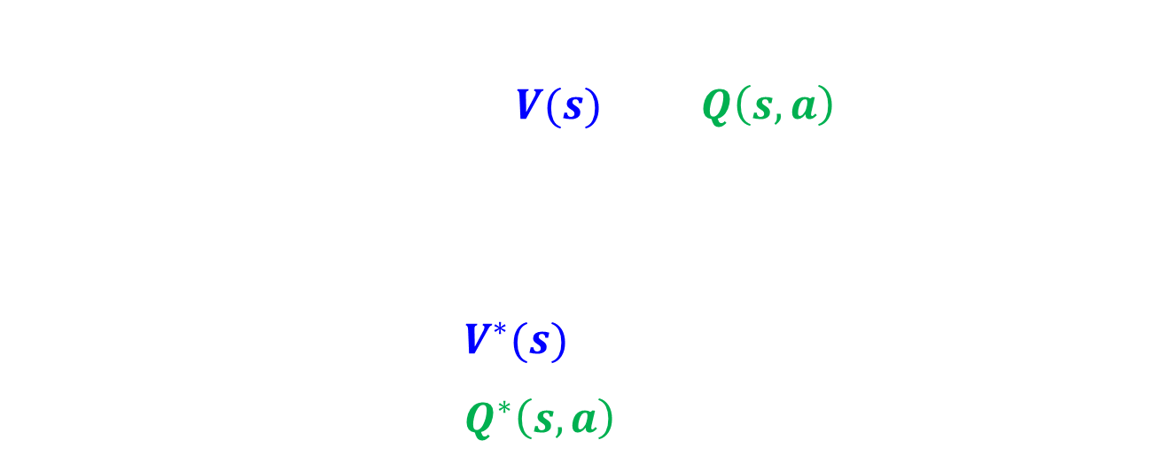
The Bellman Equations
s
The Bellman Equations define a relationship, which when satisfied guarantees that $V(s)$ and $Q\left(s,a\right)$ are optimal for each state and action.
This in turn guarantees that the policy $π^{∗}$is optimal.
There is one equation $V^{∗}(s)$ for each state s.
There is one equation $Q^{∗}\left(s,a\right)$ for each state s and action a.
a
s, a
s,a,s’
s’
Credit: CS188 – Intro to AI, UC Berkeley, ai.berkeley.edu
Credit: CS181 – Machine Learning, D. Parkes, Harvard Univ, Spring 2017
Notes:
Let’s start by equations that characterize these quantities through mutual recursions. [step through this by writing on slide, one step at a time]
Recursive characterization of V* in terms of V*; not necessarily helpful; but it is a characterization.
Note: this is a set of equations that needs to be satisfied; but it could have multiple solutions (it does not, but at this stage of our knowledge it could).

Slide 18

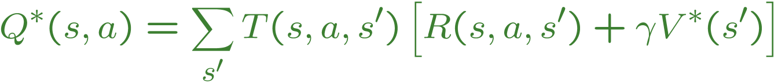
The Bellman Equations
s
a
s, a
s,a,s’
s’
<https://en.wikipedia.org/w/index.php?title=Markov_decision_process&oldid=855934986> [accessed 11 September 2018]

Slide 19
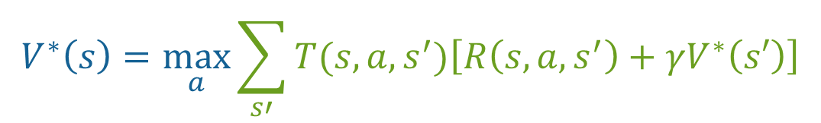
The optimal Value utility Equation V*
Focusing on different Bellman Equations Gives Different Algorithms
The V* equation gives rise to these algorithms previously discussed:
Expectimax
Value Iteration
Policy Iteration
[1]
[2]
$$V^{∗}\left(s\right)=\max_{a}\sum_{s′}{T(s,a,s^{′})\left[R\left(s,a,s^{′}\right)+γV^{∗}\left(s′\right)\right]}$$
Credit: CS188 – Intro to AI, UC Berkeley, ai.berkeley.edu
Credit: CS181 – Machine Learning, D. Parkes, Harvard Univ, Spring 2017

Slide 20
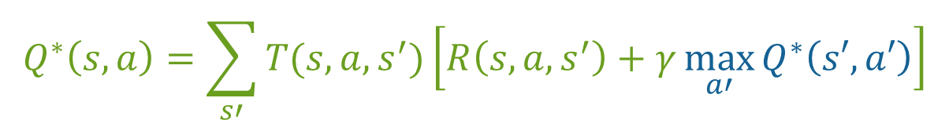
The optimal Value utility Equation Q*
[1]
The Q* equation gives rise to the Q-Learning algorithm.
[2]
$$Q^{∗}\left(s,a\right)=\sum_{s′}{T(s,a,s^{′})\left[R\left(s,a,s^{′}\right)+γ\max_{a′}{Q^{∗}\left(s′,a′\right)}\right]}$$
Credit: CS188 – Intro to AI, UC Berkeley, ai.berkeley.edu
Credit: CS181 – Machine Learning, D. Parkes, Harvard Univ, Spring 2017

Slide 21


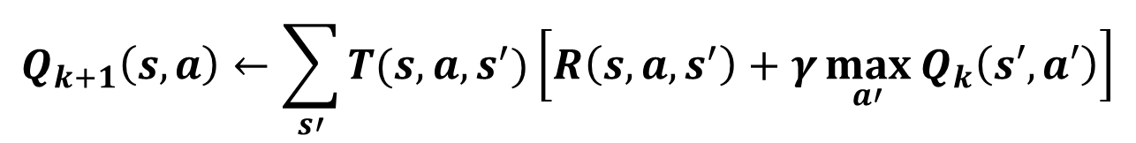
Q-Learning Update Rule (1)
What to do about T(s,a,s’) and R(s,a,s’), since we don’t have these functions?
$$Q_{k+1}\left(s,a\right)←\sum_{s′}{T(s,a,s^{′})\left[R\left(s,a,s^{′}\right)+γ\max_{a′}{Q_{k}\left(s′,a′\right)}\right]}$$
Use sampling to learn Q(s,a) values as you go
Receive a sample transition: (s,a,r,s’)
Consider your old estimate: $\text{Q}\left(s,a\right)$
Consider your new sample estimate:
Incorporate the new estimate into a running average based on the learning rate $α$:
$$r+γ\max_{a′}{Q_{k}\left(s′,a′\right)}$$
$$Q\left(s,a\right)←\left(1−α\right)Q\left(s,a\right)+α\left[r+γ\max_{a′}{Q_{k}\left(s′,a′\right)}\right]$$

Slide 22

Q-Learning update rule (2)
On transitioning from state s to state s’ after taking action a, and receiving reward r, update:
$α$ is the learning rate
A large $α$ results in quicker learning but may not converge.
$α$ is often decreased as learning goes on.
$γ$ is the discount rate i.e., discounts future rewards.
$$Q\left(s,a\right)←\left(1−α\right)Q\left(s,a\right)+α\left[r+γ\max_{a′}{Q_{k}\left(s′,a′\right)}\right]$$

Slide 23

Q-Learning algorithm
For each state s and action a:
$Q\left(s,a\right)←0$
Observe initial state s
Repeat:
Select and carry out an action a
Receive reward r and observe new state s’
With transition <s,a,r,s’>, update Q(s,a):
$Q\left(s,a\right)←\left(1−α\right)Q\left(s,a\right)+α\left[r+γ\max_{a′}{Q_{k}\left(s′,a′\right)}\right]$
s $←s′$
Until terminated

Slide 24
The Q-Learning Algorithm Converges to the True q-value
The max_{a’} Q(s’,a’) that we use to update Q(s,a) is only an approximation and in early stages of learning it may be completely wrong.
However the approximation get more and more accurate with every iteration and it has been shown, that if we perform this update enough times, then the Q-function will converge and represent the true Q-value.
<https://www.intel.ai/demystifying-deep-reinforcement-learning> [accessed 29 January 2020]

Slide 25
choosing an action: exploration vs exploitation
How should an agent choose an action? An obvious answer is simply to follow the current policy. However, this is often not the best way to improve your model.
Exploit: use your current model to maximize the expected utility now.
Explore: choose an action that will help you improve your model.

Slide 26

ϵ-Greedy Method
At time t, estimate the expected value for each action:
$Q_{t}\left(a\right)=\frac{\text{Sum} \text{of} \text{rewards} \text{when} \text{action} \text{a} \text{is} \text{taken} \text{prior} \text{to} \text{t}}{\text{Number} \text{of} \text{times} \text{action} \text{a} \text{is} \text{taken} \text{prior} \text{to} \text{t}}$
With probability 1 - ϵ, select the action with the maximum value.
$$A_{t}=argmax Q_{t}(a)$$
With probability ϵ, randomly select an action from all the actions with equal probability.

Slide 27
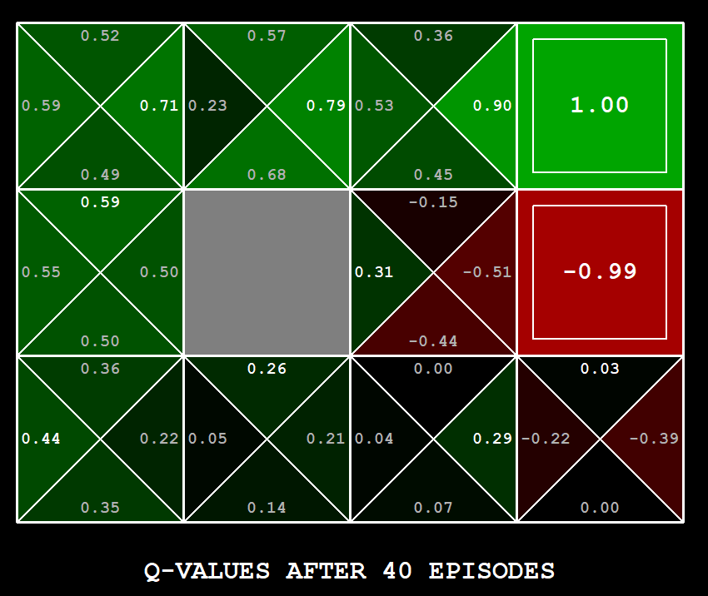
Q-Learning Example: gridworld
Notes:
python gridworld.py -k 40 -w 200 -s 2.0 -a q –v [-p]

Slide 28
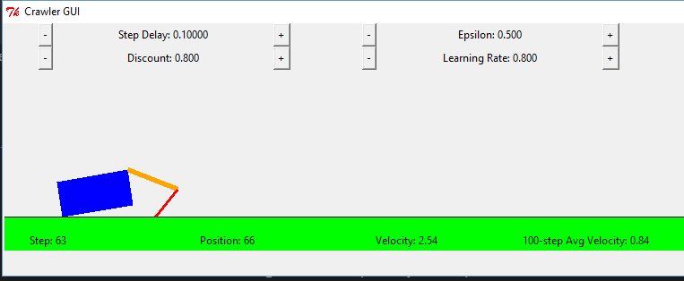
Q-Learning Example: Crawler Robot
Credit: CS188 – Intro to AI, UC Berkeley, ai.berkeley.edu

Slide 29
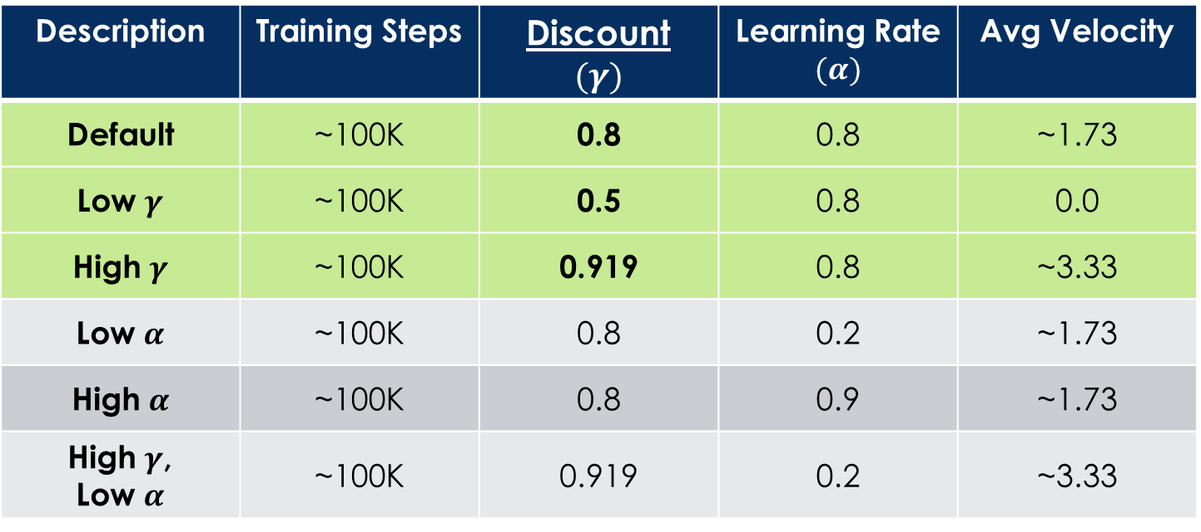
Q-Learning Example: discount effect
Update rule:
Description | Training Steps | Discount $$(γ)$$ | Learning Rate $$(α)$$ | Avg Velocity
Default | ~100K | 0.8 | 0.8 | ~1.73
Low $γ$ | ~100K | 0.5 | 0.8 | 0.0
High $γ$ | ~100K | 0.919 | 0.8 | ~3.33
Low $α$ | ~100K | 0.8 | 0.2 | ~1.73
High $α$ | ~100K | 0.8 | 0.9 | ~1.73
High $γ$, Low $α$ | ~100K | 0.919 | 0.2 | ~3.33

Slide 30
Introduction To Q-learning
Scott O’Hara
Metrowest Developers Machine Learning Group

